Slide 1
Rethinking Patient Safety: Navigating the measurement and monitoring safety clouds.
A leaders’ self-reflection and discussion activity.
Notes:
This slide deck has been created to support the facilitation of the activity - NAVIGATING THE MEASUREMENT AND MONITORING SAFETY CLOUDS: LEADERS’ SELF-REFLECTION AND DISCUSSION
Please refer to the activity card for more details about the activity and instructions for hosting.
Please feel free to modify this deck to suit your audience and facilitation style.
Senior leaders are key champions for Rethinking Patient Safety. This activity encourages self-reflection by senior leaders in five domains of the Measurement and Monitoring of Safety Framework (MMSF), which has formed the foundation for Rethinking Patient Safety. It is intended to support reflection and discussion around current approaches for measuring and monitoring safety in all sectors of healthcare – from acute care and rehabilitation, long term care, and care in home and community. While we have made progress on reporting and learning from harm, it is now time to maximize learning from other sources of safety information. Each dimension of MMSF is represented as a ‘safety cloud’ comprised of two themes and questions to reflect on and discuss.
What are safety cloud themes?
The exercise involves exploring all five domains of the MMSF (past harm, reliability, sensitivity to operations, anticipation & preparedness, and integration & learning) using safety clouds. Each safety cloud is comprised of two themes for which leaders may first self-reflect, and then hold reflective conversations
The themes in each safety cloud represent common challenges healthcare organizations may face as they move toward Rethinking Patient Safety and evolve their approach to measuring and monitoring safety.
All five domains of the MMSF and each safety theme is explained in detail in this slide deck. Some of the themes will resonate with you more than others. Your organization may have denser clouds for one or two themes.
We recommend you break down the activity into bitesize chunks. For example, you may opt to work through one safety cloud and its associated themes in each reflective leadership conversation or take one of the themes in each safety cloud and discuss it, then have a conversation about the next theme at your next Board or senior leadership meeting, retreat or in another forum. What matters is that you have an honest, open and inclusive conversation about the challenges related to each safety theme and associated question.
Do not try to have reflective conversations about all ten themes in one session. A series of deeper, more meaningful conversations spread out over time will enable you to thoroughly explore each safety theme.

Slide 2
Outline
Introduction
  Measurement and Monitoring of Safety Framework (MMSF)
  Rethinking Patient Safety (RPS)
  MMSF safety clouds and themes
Past harm
  Theory
  Reflections on current state
  Theme 1 - Measuring and monitoring past healthcare harm
  and health inequities
  Theme 2 - System-focused’ versus ‘person-focused’ recommendations
  Take away task
  Reflections on future state

Slide 3
Outline
Reliability
  Theory
  Reflections on current state
  Theme 3 - The normalization of unreliable clinical systems and processes
  Theme 4 - Understanding the limitations clinical system & process audits
  Reflections on future state
Sensitivity to operations
  Theory
  Reflections on current state
  Theme 5 - Capacity to tune into ‘work as done’
  Theme 6 - Creating psychological safety
  Reflections on future state
  Additional tools and resources

Slide 4
Outline
Anticipation & preparedness
  Theory
  Reflections on current state
  Theme 7 - Looking at other data sets differently
  Theme 8 - Horizon scanning to proactively identify emerging and future safety
  Reflections on future state
Integration & learning
  Theory
  Reflections on current state
  Theme 9 - Knowing learning happens
  Theme 10 - Preventing integration fog
  Reflections on future state
Additional resources

Slide 5
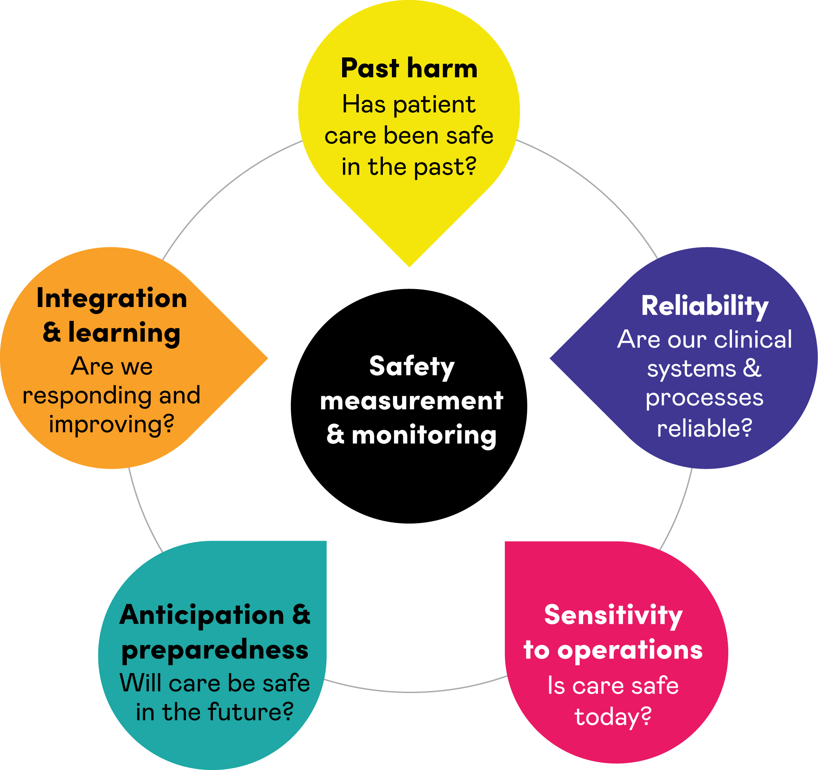
Measurement and Monitoring of Safety Framework
The measurement and
monitoring of safety -
The Health Foundation
Notes:
The Measurement and Monitoring of Safety Framework provides a conceptual model to healthcare organisations in their efforts to improve safety. The nature of safety has been discussed in the wider literature but, in healthcare at least, there has been little consensus on the core dimensions of safety or what exactly should be measured and monitored. The MMSF captures and integrates all the critical dimensions of safety in one framework and provides examples of how these various concepts might be realised in practice within organisations across health sectors, from acute care and rehabilitation, long term care, home and community care. The Measurement and Monitoring of Safety (MMS) Framework attempted to synthesise the wider theory, literature and practice from both healthcare and other industries in a form which aimed to be accessible and useful to all healthcare organisations. The Framework comprises five dimensions or lenses on safety; past harm. Reliability, sensitivity to operations, anticipation and preparedness, and integration and learning.
For more information about the Measurement and Monitoring of Safety Framework, please refer to the link on the slide

Slide 6
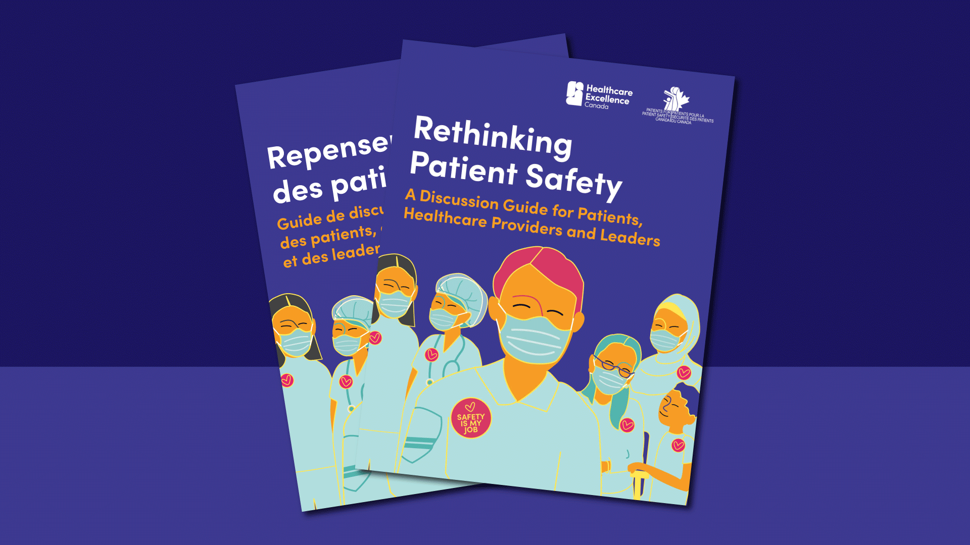
Rethinking Patient Safety (healthcareexcellence.ca)
Notes:
Like the Measurement and Monitoring of Safety Framework, Rethinking Patient Safety (Healthcare Excellence Canada, October 2023) recognizes that safety is much more than the absence of harm. To improve patient safety, we must start by thinking and talking about it differently.
Improving patient safety requires us to look at the whole system: its past, present and future in all its complexity.
Rethinking Patient Safety was released in 2022 by Healthcare Excellence Canada. It was developed because despite 20 years of efforts to improve patient safety, we haven’t been as successful as we had hoped. Healthcare Excellence Canada is encouraging everyone to rethink how they have been defining and approaching patient safety improvement work.
The core statement within Rethinking Patient Safety Reads –
“Everyone contributes to patient safety. Together we must learn and act to create safer care and reduce all forms of healthcare harm.”
It includes a table for reflection and a list of questions for discussion.
For more information about Rethinking Patient Safety, please refer to the link on the slide.

Slide 7





Measurement and
Monitoring Safety
Clouds & Safety Themes
Past harm
Measuring and monitoring past healthcare harm and health inequities.
Strong ‘system-focused’ versus weak, ‘person-focused’ recommendations
Integration
and learning
Reliability
Normalization of unreliable systems and processes
Understanding the limitations of clinical systems & process audits
Knowing how feedback
and learning happens
Preventing integration fog
Anticipation
and preparedness
Sensitivity
to operations
Looking at other data sets differently
Horizon scanning to proactively identify emerging and future safety risks
Capacity to tune into ‘work as done’
Creating psychological safety when gathering insight
Notes:
Here is an overview of the five safety clouds and ten safety themes that make up the leaders’ self-reflection and discussion activity. Each safety cloud and theme will be discussed in greater detail in the following slides.

Slide 8
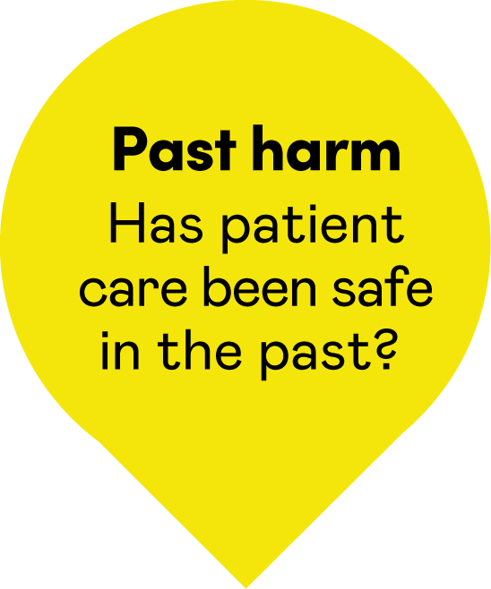
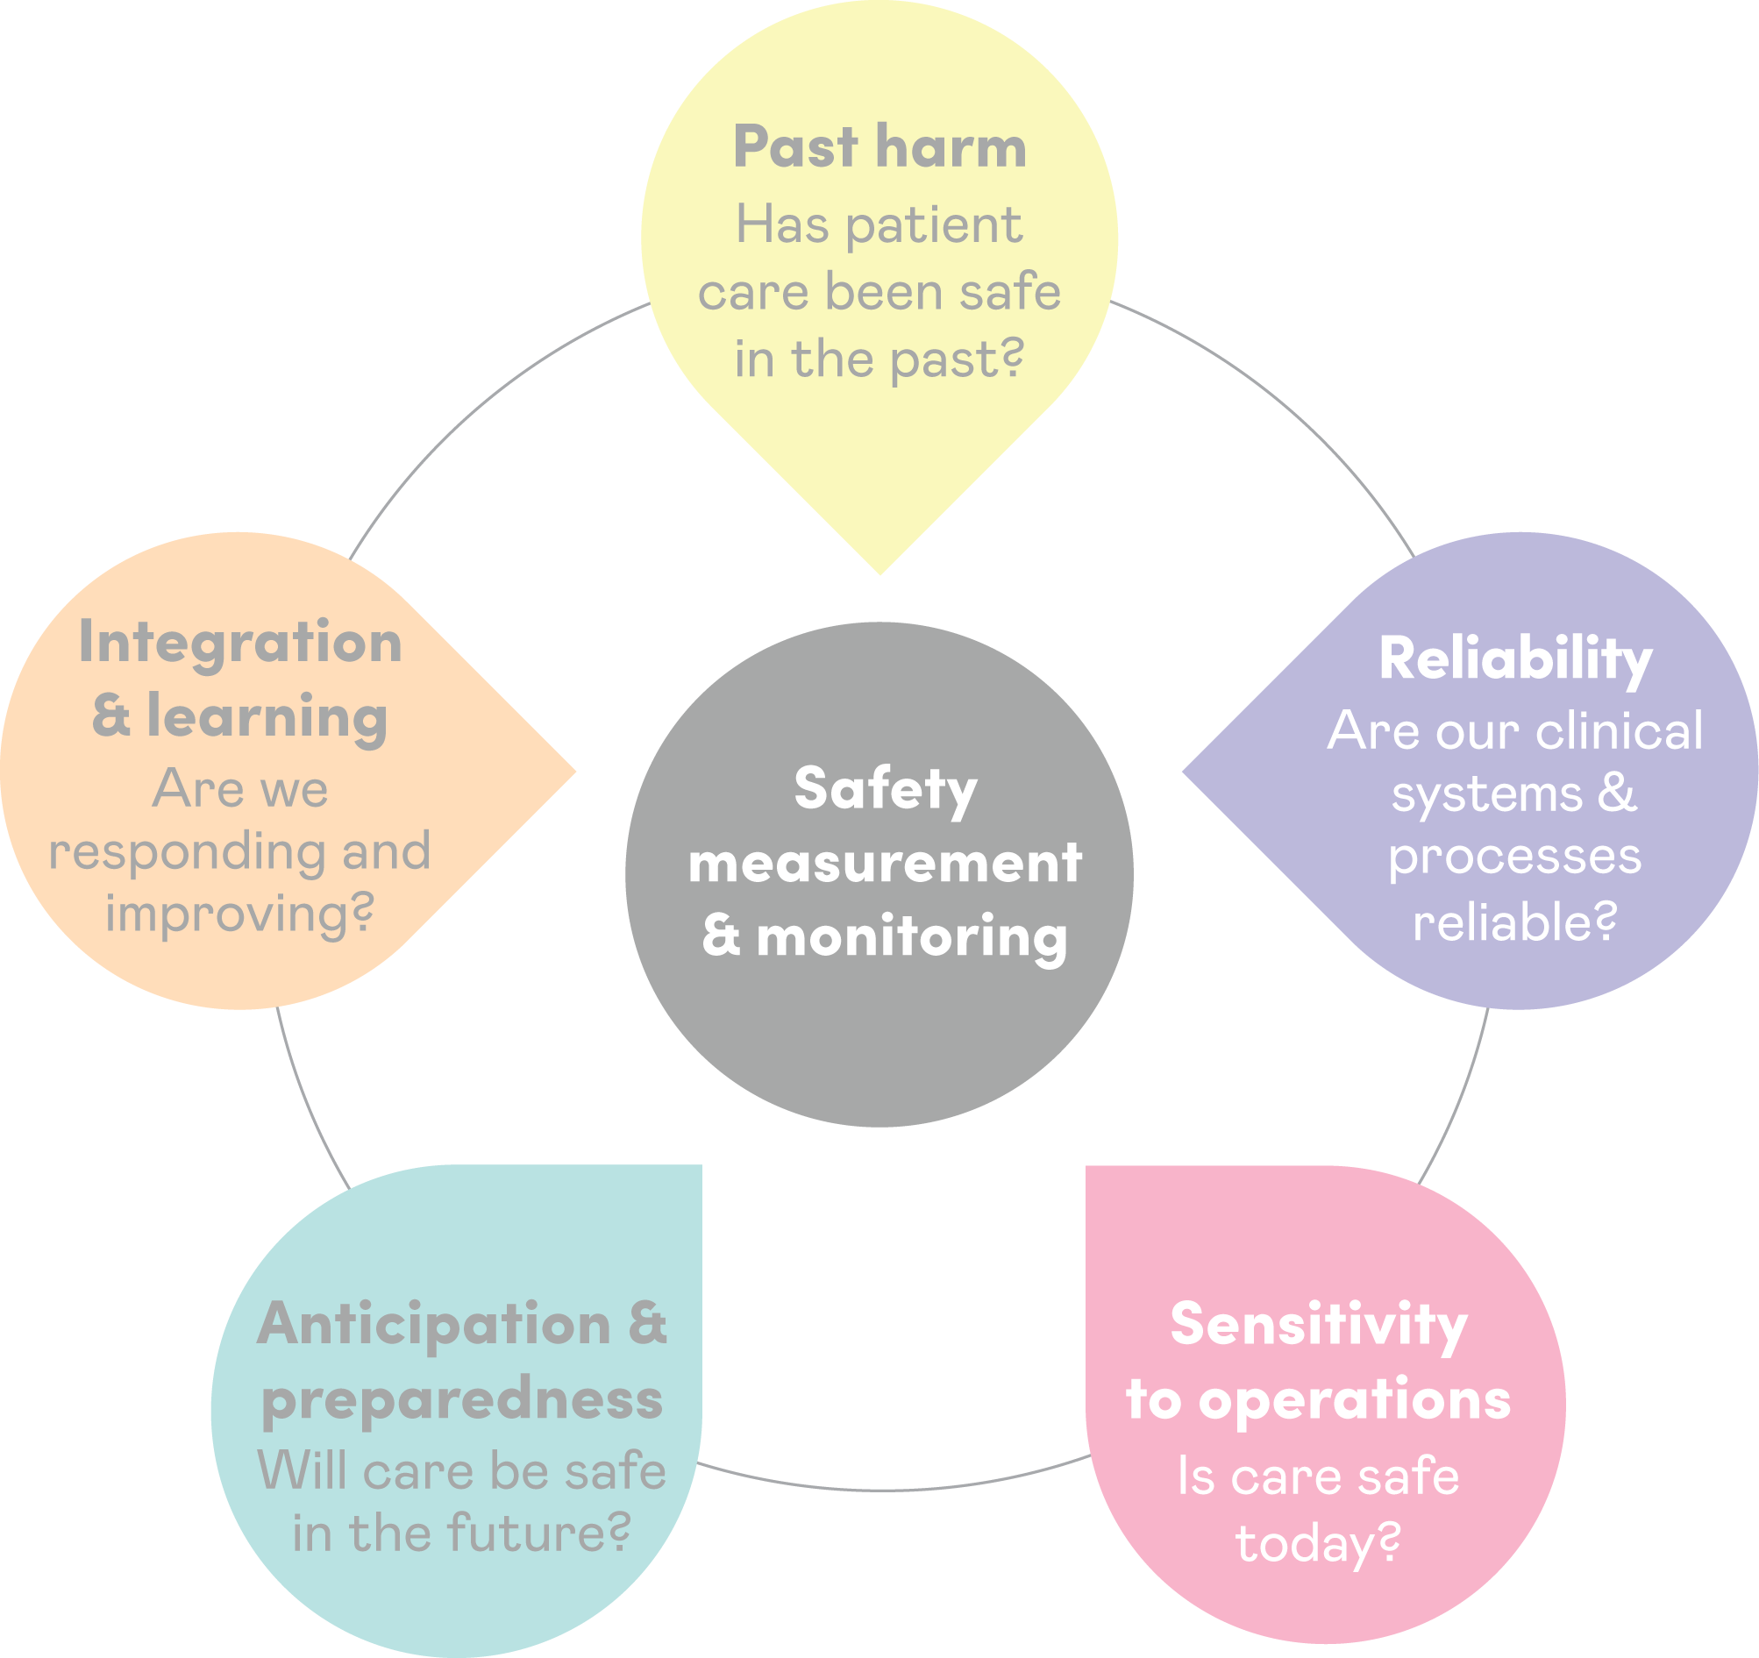
Past harm

Slide 9

Past harm - Has care
been safe in the past?
Past Harm is the measurement of multiple types and aspects of harm to help assess whether care has been safe in the past and is becoming safer
v
Past harm is often referred to as “looking in the rear-view mirror”
It involves re-visiting past events so we can learn and improve
Notes:
Past harm – Has care been safe in the past?
This dimension underscores that “Measuring harm is not equivalent to measuring safety but is an essential foundation” it is important but alone it is not enough to move the mark on safety.
In this dimension, past harm is the measurement of multiple types and aspects of harm to help assess whether care has been safe in the past and is becoming safer. For example, how long ago did the harm occur, and how much harm has there been over time.

Slide 10
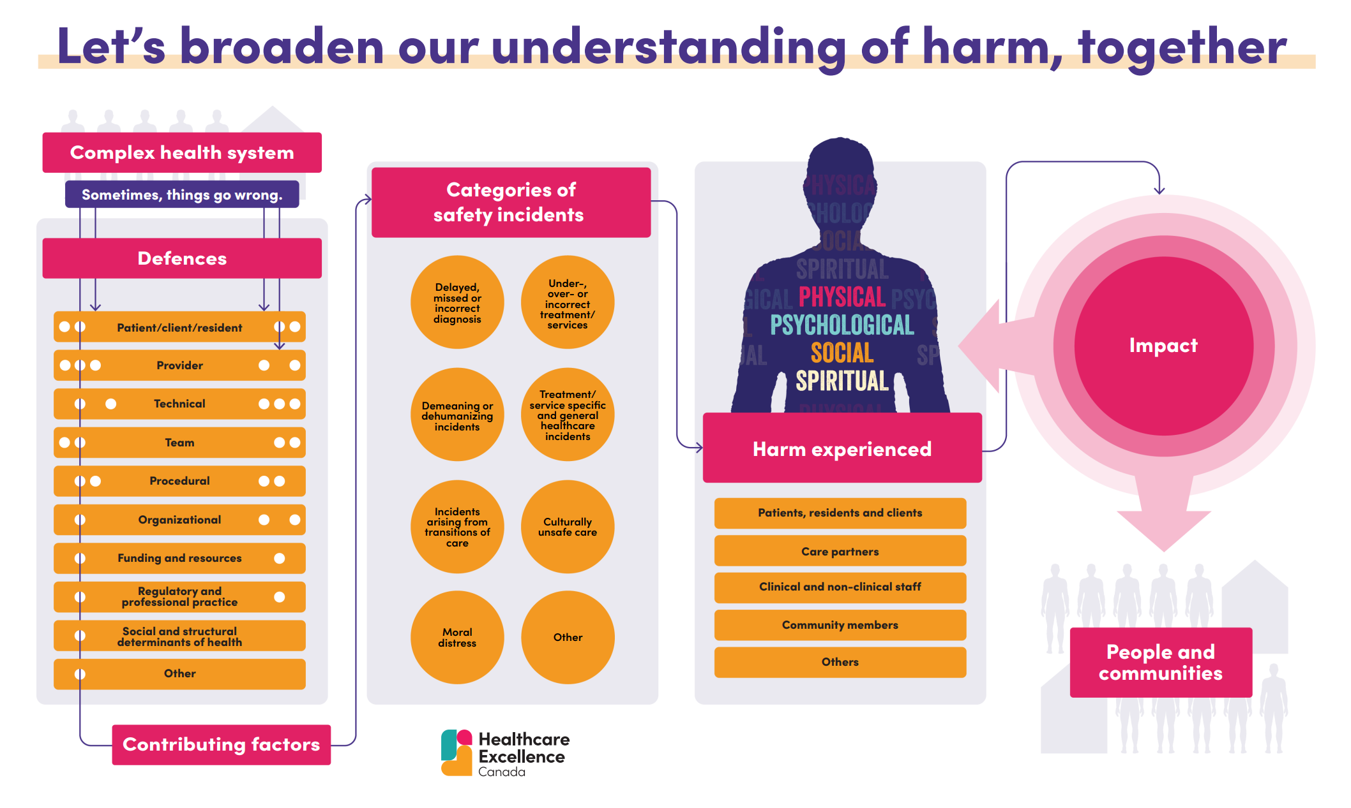
Let’s broaden our understanding of harm, together
Notes:
Recognizing and reducing healthcare harm matters to those receiving and delivering care in any setting. As part of championing Rethinking Patient Safety, everyone is being encouraged to broaden their understanding of healthcare harm as an important step in delivering safer care for all.
On the screen you will see an infographic created by Healthcare Excellence Canada to help broaden our understanding of healthcare harm. Within this infographic there are five main concepts that we are describing:
Factors that can promote safety and factors that contribute to safety incidents and harm.
Categories of safety incidents that can potentially lead to harm.
The harm experienced.
Who was harmed.
The lasting impact of the harm on people and communities
Healthcare Excellence Canada has developed an activity to stimulate discussions and thoughtful reflections about a broader understanding of healthcare harm that can be done with your teams. It is available for download at Understandharm.ca

Slide 11
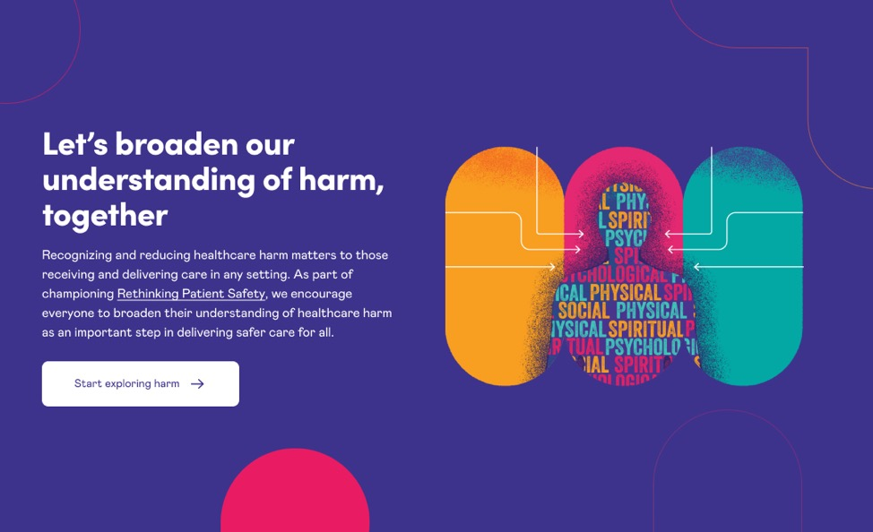
Digital infographic
UnderstandHarm.ca
Notes:
To further explore healthcare harm and to learn more about five main concepts captured in the infographic – please refer to the interactive digital version available at Understandharm.ca

Slide 12
How do we currently answer the question “Has care been safe in the past?”
Notes:
Following a brief introduction to “past harm”, but prior to exploring a broader view of harm and the past harm safety theme clouds -
Think and reflect on the question - How do we currently answer the question “Has care been safe in the past?”

Slide 13
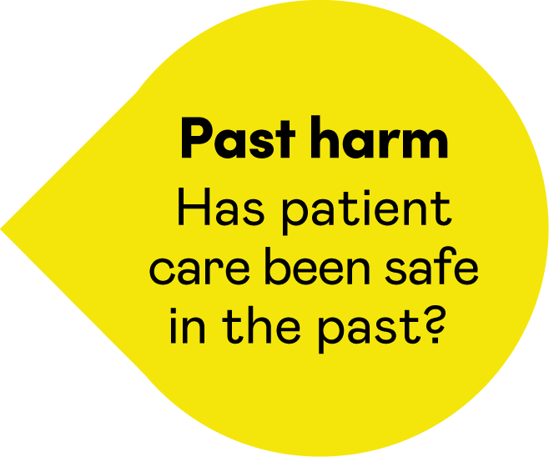
Past harm
Measuring and monitoring past healthcare harm and health inequities.
Strong ‘system-focused’ versus weak, ‘person-focused’ recommendations

Slide 14
Safety Cloud Theme 1:
Measuring and monitoring past healthcare harm and health inequities
Reflective question
How might we improve our understanding of past healthcare harm, so we know whether patients and communities with social and systemic inequities are more likely to experience healthcare harm related to patient safety incidents?

Slide 15
Safety Cloud Theme 1:
Measuring and monitoring past healthcare harm and health inequities
Background
We know based on the evidence and the lived experiences of people
and communities that there are barriers to receiving safe and high-quality healthcare as a result of social and systemic inequities. For example:
Maternity and obstetric safety incidents
Overuse of restraints
Over sedation & tranquilization
Seclusion in mental health settings
This in turn may lead to safety incidents which can potentially
cause physical, psychological, social, and/or spiritual harm.
Notes:
Categories of safety incidents includes delayed, missed or incorrect diagnosis; over-, under- or incorrect treatment/services; demeaning and dehumanizing incidents, culturally unsafe care; moral distress; etc. - Refer to the slide about broadening our understanding of healthcare harm and visit Understandharm.ca for more examples of safety incidents and details about healthcare harm.
Resources / evidence to support examples related to maternity incidents, overuse of restraints, over sedation, and seclusion in mental health settings:
The impacts of racism on healthcare quality and safety in canada: a case study and practical advice from ontario midwifer
Obstetric racism and perceived quality of maternity care in Canada: Voices of Black women Research evidence has shown for example, that black and indigenous women have higher rates of pregnancy related deaths, pre-term births, low birthweight babies or births for which they receive little or no prenatal care compared to white women (Hill et al., 2022)
First Nations, Inuit, and Metis people experience traumatic use of restraints. Specific case example Remembering Keegan there is also a CBC report, here.
Potential Quote: ‘Survivors have testified to abuses – including use of restraints – in these schools and hospitals.13, 48, 49 This is not abstract in the context of health services that are delivered in BC in close proximity to the 21 former residential schools and three former Indian hospitals (Coqualeetza Indian Hospital in Chilliwack, Miller Bay Indian Hospital in Prince Rupert and Nanaimo Indian Hospital in Nanaimo)’
‘In a recent analysis of CAMH data, rates of restraint use were 44 per cent higher among Black patients than among white patients’ (camh-dismantling-anti-black-racism-pdf.pdf)
‘Black Ontarians experience higher rates of restraint and confinement under the care of the mental health and addictions system’ HEALTH INEQUITIES (blackhealthalliance.ca)

Slide 16
Safety Cloud Theme 1:
Measuring and monitoring past healthcare harm and health inequities
This safety cloud theme is asking
you to consider:
What does your organization’s past harm data look like,
and does it give you insights into health inequities?
Can you identify specific incidents that make the issue of inequities and patient safety incidents easier to see?
How might you strengthen your organizational knowledge to gain insights into the impact health inequities has on patient safety?
Notes:
Additional questions to consider from Rethinking Patient Safety are:
What comes to mind when you think of healthcare harm?
How can action on patient safety help reduce health inequities?
How can action on health inequities help improve patient safety?

Slide 17
Safety Cloud Theme 2:
‘System-focused’ versus
‘person-focused’ recommendations
Reflective question
How many of the recommendations from our incident investigation reports focus on improving the design of the healthcare system (i.e. system focused) and how many focus on asking point of care healthcare staff to comply, try harder or do additional tasks (i.e. person-focused)?

Slide 18

Safety Cloud Theme 2:
‘System-focused’ versus
‘person-focused’ recommendations
Background
Incident investigations in healthcare often lead to ‘person-focused’ recommendations that human factors experts have found to be less effective.
Human factors research shows us that when we rely solely on person-focused recommendations, the same types of incident
are likely to recur.
Designing healthcare systems to enable staff to deliver safe patient care will achieve greater improvements in safety than simply telling staff to comply, do better or do more.
Notes:
Background:
Incident investigations in healthcare often lead to what human factors experts call, ‘weak, person-focused’ recommendations, for example, reminding staff to comply with safety policies and procedures, introducing more safety policies and procedures or additional safety checks. (Refer to the summary table of Strong, moderately strong and weak recommendations on the next slide)
Human factors research shows us that when we rely solely on person-focused recommendations, the same types of incident are likely to recur.
Our focus needs to be on designing healthcare systems which enable staff to deliver safe patient care.
Healthcare leaders need to understand that some solutions and recommendations that are ‘person-focused,’ will be less strong than those which focus on redesigning healthcare systems and reengineering cultures are the strongest. (Refer to the summary table of Strong, moderately strong and weak recommendations on the next slide)
Designing healthcare systems to enable staff to deliver safe patient care will achieve greater improvements in safety than simply telling staff to comply, do better or do more.

Slide 19

Strong, moderate and weak recommendations summary table
Recommendation strength | Types
Strong | Redesign a healthcare pathway, process or other part of the work environment
 | Engineering controls like designing in a ‘forcing function.’
 | Effect cultural improvement to develop a psychologically safe culture
 | Redesign equipment, IT systems to improve their usability, accessibility, and functionality
 | Simplify or standardize processes, pathways, or equipment
 | Carry out usability testing (formative and summative) when implementing new equipment, workplaces or IT systems.
Moderate | Resolve equipment availability problems
 | Resolve staffing problems
 | Reorganize workload to address high workload or task overload
 | Develop and deliver simulation-based training
 | Enhance documentation or communication
 | Eliminate or reduce distractions and interruptions
 | Introduce a safety checklist
 | Review rostering or the appropriateness of the staff mix.
Weak | Add in additional safety checks for staff to carry out
 | Raise staff awareness of a policy or process
 | Carry out an audit or review
 | Increase staff supervision
 | Informing, notifying, issuing warnings
 | Discipline or suspend staff who make errors
 | Rewrite safety policies and procedures
 | Introduce more safety policies and procedures
 | Check staff understanding of safety processes (without considering how work is actually done).
 | Share the investigation findings
 | Carry out didactic training which involves reminding staff about safety policies and procedures, or ‘counselling’ staff about the way to deliver safe patient care.
 | Other recommendations which do not take account of the workflow and task demands in a clinical area.
Notes:
Facilitator notes: Explain that the table on the slide has been developed based on research which shows that some types of recommendations are weaker than others. When recommendations from incident investigation reports are ‘person-focused’ they are weak because the underlying design flaws and systems weaknesses are not resolved. Relevant research papers on which the table is based are: i. Hibbert, Thomas, Deakin et al (2018). Are recommendations from root cause analysis effective and sustainable. An observational study. International Journal of Quality in Health Care, 30; 124-131 and ii. Cafazzo and St Cyr (2012), From discovery to design: the evolution of human factors in healthcare. Healthcare Quality, 2012:15 Spec No:24-9. doi: 10.12927/hcq.2012.22845.
(another resource to reinforce this point: To Improve Health Care, Focus on Fixing Systems — Not People by Mate, Clark, and Salvon-Harman, Harvard Business Review (July 12, 2024). https://hbr.org/2024/07/to-improve-health-care-focus-on-fixing-systems-not-people

Slide 20
Healthcare Organization A's breakdown of strong, moderately strong, and weak recommendations from incident investigation reports
Strong
System-focused
Moderate
Weak
Person-focused
Notes:
The slide shows the mocked up organizational profile which is typical of what we see when we carry out an analysis of recommendations in incident investigation reports.
Share some examples of the weak, person-centred recommendations, the moderately strong and strong ‘system-focused’ recommendations when you introduce the task.
Then ask those participating to discuss the reflective question, ‘How many of the recommendations from our incident investigation reports focus on improving the design of the healthcare system (i.e. system focused) and how many focus on asking point of care healthcare staff do comply, try harder or do additional tasks (person-focused)?’

Slide 21
Safety Cloud Theme 2:
‘System-focused’ versus
‘person-focused’ recommendations
This safety theme cloud is asking you to:
Look at the mocked-up profile for Organization A and the table of what
have been deemed weak, moderate and strong recommendations.
As a leader, consider the recommendations put forward
in your organization’s incident investigations.
  What would your organizational profile look like?
  What needs to change?
Notes:
The question is asking you, as a leader, to consider the recommendations put forward in the organization’s incident investigations. Look at the mocked-up profile for Organization A and the table of what has been deemed weak, moderately strong and strong recommendations (previous slides) . What would your organizational profile look like? What needs to change?

Slide 22

Take away task
Source five recently completed incident investigation reports from your organization.
Read the recommendations section of the report.
Do the recommendations match your perception
of what your organization’s recommendations
focus on (i.e. are they mainly person-focused
or system-focused)?
Any surprises?
Notes:
We have added in a takeaway task to this exercise. Ask the senior leaders who participate in the reflective exercise to source five incident investigation reports from their organization. The task is for them to consider whether their perceptions of how strong or weak the recommendations in the incident investigation reports match their perception of the strength of recommendations, and what they have shared in the reflective exercise. Were there any surprises?
Carrying out the takeaway task may confirm they, as leaders, need to support those leading investigations to reconsider the types of recommendations that we put forward. How might they do that?

Slide 23
How can we better answer the question “Has care been safe in the past?”
Notes:
Now that you have explored a past harm, have been introduced to a broader view of healthcare harm, and have completed the two “past harm” safety theme clouds…
Refer to your notes from the discussion on - How do we currently answer the question “Has care been safe in the past?”
Think and reflect on the question - How can we better answer the question “Has care been safe in the past?”

Slide 24
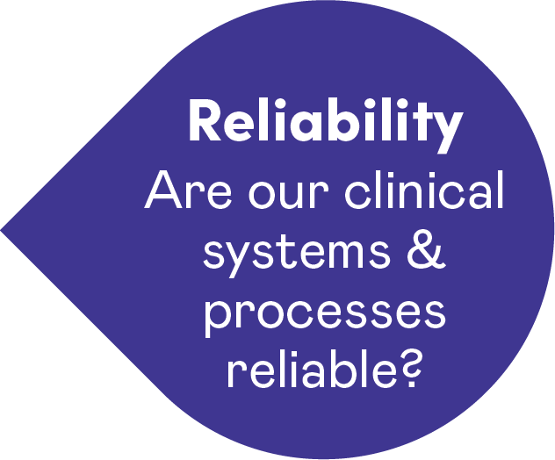
Reliability

Slide 25


Reliability- Are our clinical systems and processes reliable?
Reliability is gauging the probability that a task, process, intervention,
or pathway will be carried out or followed as specified.
What would happen if we had
a system of only measuring the number of people who fell through the ice rather than measuring the thickness of the ice?
Notes:
Reliability- Are our clinical systems and processes reliable?
This dimension really poses the question: are our clinical systems and processes reliable and if they are not, what might that mean for the safety of the patient?
What is Reliability?
“Failure-free operation over time” applies mostly in technology
“Gauging the probability that a task, process, intervention, or pathway will be carried out or followed as specified.”
In healthcare we must recognize that variation is necessary given differences in patients and in care environments; treatments are adapted to fit patient needs
Sources of poor reliability include staff skills and experience and team factors, including poor communications, inadequate design of clinical environments and supports systems, and the view of clinical staff that systems are unreliable, and it is not their role to ensure reliability
Examples of Reliability measures-
hand hygiene,
the timely administration of pre-operative antibiotics,
the timely ordering of diagnostic tests,
medication review and reconciliation,
surgical checklists
availability of clinical information / patient records,
availability and efficient functioning of equipment,
administration of radiotherapy
availability of supplies
on-time visits
continuity of care- how often patients/clients receive care from the same provider
completion of staff training/continuing education

Slide 26
How do we currently answer the question “Are our clinical systems and processes reliable?”
Notes:
Think and reflect on the question - How do we currently answer the question “Are our clinical systems and processes reliable?”

Slide 27
Reliability
Normalization of unreliable systems and processes
Understanding the limitations of clinical systems & process audits

Slide 28
Safety Cloud Theme 3:
The normalization of unreliable clinical systems and processes
Reflective question
Which clinical systems and processes
in your organization are like a dripping
tap that never gets fixed?
Why are they not ‘fixable’?

Slide 29
Safety Cloud Theme 3:
The normalization of unreliable clinical systems and processes
Background
Unreliable clinical systems and processes can sometimes create safety risks.
Examples include:
  booking systems that create unworkable schedules for staffing,
  clinics, and operating rooms, etc.
  multiple patient information systems which do not talk to each other
  equipment not being available or working when needed,
  work environment-related problems like poor wi-fi connectivity, etc.
Notes:
Unreliable clinical systems and processes can sometimes create safety risks. Examples include booking systems that create unworkable schedules for staffing, clinics, and operating rooms, etc. Other types of unreliable clinical systems include multiple patient information systems which do not talk to each other, equipment not being available or working when needed, work environment-related problems like poor wi-fi connectivity, etc.

Slide 30
Safety Cloud Theme 3:
The normalization of unreliable clinical systems and processes
This safety theme cloud
is asking you to:
reflect on the systems and processes
in your organization which are tolerated, worked-around and have become normalized.

Slide 31
Safety Cloud Theme 4:
Understanding the limitations
clinical system & process audits
Reflective question
When we review audits of clinical processes and systems, do the conversations we have consider the potential negative side effects and/or limitations of the audit approach?

Slide 32
Safety Cloud Theme 4:
Understanding the limitations
clinical system & process audits
Background
Healthcare audits which measure percentage compliance based on what is documented in patients’ healthcare records may create a false sense of compliant behaviour.
Examples include:
percent completion of client care plans, falls risk assessments,
Surgical Safety Checklist
recording of vital signs, and pressure sore prevention and other care bundles.
hand hygiene audits where staff are aware the auditor has come to observe their practice.

Slide 33
Safety Cloud Theme 4:
Understanding the limitations
clinical system & process audits
This safety theme cloud is asking you to:
Reflect on how you as leaders get assurance the data shown in safety audits reflects how care is given, rather than just measuring what is documented or a performance given when a healthcare team member knows their practice is being observed.
How can you as leaders use the practice of inquiry to gain insights
into the reliability of your clinical systems and process?

Slide 34
How can we better answer the question
“Are our clinical systems and processes reliable?”
Notes:
Now that you have explored reliability, and have completed the two “reliability” safety theme clouds…
Refer to your notes from the discussion on - How do we currently answer the question “Are our clinical systems and processes reliable?”
Think and reflect on the question - How can we better answer the question “Are our clinical systems and processes reliable?”
When looking at improving your measures of reliability some things to consider are:
Standardization of measures – is everyone measuring the same thing in the same way.
Do our measures of reliability measure what we intend for them to measure, or are they audits of documentation?
Are you consistent in your approach to reliability – not yes/no but is everyone going deeper into the details of the process?
Are your measures of reliability customised to local settings and circumstances e.g., reliability measures specific to mental health likely differ from those in ICU which will differ from those in primary/community care
Auditing vs coaching – if you are looking to improve practice or behaviour would you rather be audited or coached?
Explore the concept of “work as imagined” vs “work as done”
Staff often accept unreliable processes as just part of the job…often pride themselves in work arounds they develop.

Slide 35
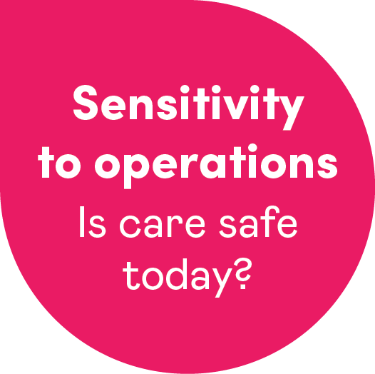
Sensitivity to operations

Slide 36



Sensitivity to operations: Is care safe today?
Observing
Listening
Perceiving
Sensitivity to operations concentrates on the day-to-day, hour-by-hour and even minute-by-minute management of safety.
It involves capturing safety intelligence through observing, listening and perceiving the healthcare setting and then acting on the information you have gathered.
Notes:
Sensitivity to Operations asks the question is Care safe today? This domain concentrates on the day-to-day, hour-by-hour and even minute-by-minute management of safety.
It involves capturing safety intelligence through observing, listening and perceiving the healthcare setting and then acting on the information you have gathered.
This is where we start to introduce a new approach to safety. Over the past 20 years we have focused largely on past harm and reliability…the things we can count and measure. But what about those safety critical elements that we can not measure? This domain places value and emphasis on informal safety intelligence gathered from observations, intuition, critical thinking, experience, relationships and conversations.
Sensitivity to operations is really about continuously assessing if care is safe today: in order act upon safety in real time. It is about being proactive to create safety vs reacting and responding after harm has happened.

Slide 37
Is care safe today?
Individual:
Monitor patients/residents/clients/care partners watching for subtle signs of behaviour change, deterioration or improvement.
Team:
Monitor teams for signs of absenteeism, apathy,
discord, fatigue or lapses in standards.
Organization:
Be alert to the impact of staff shortages, staff health and wellbeing, availability of tools to do the work, equipment breakdowns, sudden increases in demands and a host of other potential problems.
Act on the information you have gathered!
Notes:
When looking at individual Behaviour change, think about – social, emotional, physical, activities of daily living.
Deterioration – think of physical and cognitive

Slide 38
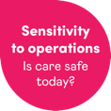
How do we build
Sensitivity to operations?
Observation activity
Safety walk rounds
Operational meetings, structured handovers and rounds
Safety tickets
Briefings and debriefings
Safety conversations
with staff and patients
Patient interviews
Safety huddles
Notes:
The next few slides offer additional resources on ways to tune into other sources of safety intelligence

Slide 39
How do we currently answer the question “Is care safe today?”
Notes:
Following a brief introduction to “Sensitivity to Operations”,
Think and reflect on the question “How do we currently answer the question “Is care safe today?”

Slide 40
Sensitivity
to operations
Capacity to tune into ‘work as done’
Creating psychological safety when gathering insight

Slide 41
Safety Cloud Theme 5:
Capacity to tune into ‘work as done’
Reflective question
How do we, as leaders, capture insights into ‘work as done?’
What else could we do to learn from what we see, hear and perceive (i.e. that which may not be presented as a number?)

Slide 42
Safety Cloud Theme 5:
Capacity to tune into ‘work as done’
Background
By ‘work as done’ we mean how healthcare is delivered
on an hour-by-hour, shift-by-shift basis.
We gather important insights into safety through:
  conversations
  observations,
  listening, and
  tuning into how care is delivered
What we see, hear and perceive is as important as metrics
we count and report.
Notes:
By ‘work as done’ we mean how healthcare is delivered on an hour-by-hour, shift-by-shift basis. The Measurement and Monitoring of Safety Framework tells us that we gather important insights into safety through conversations, observations, listening, and tuning into how care is delivered. What we see, hear and perceive is as important as metrics we count and report. For example, a healthcare professional shares that they are scared or reluctant to speak up and ask for help in their team. You observe a staff member being denigrated when they try to raise a safety concern with a senior colleague.

Slide 43
Safety Cloud Theme 5:
Capacity to tune into ‘work as done’
This safety theme cloud is asking you to:
reflect on how you as a leader get insights into ‘work as done.’
start a conversation about what else you can do to tune in by listening, observing, and tuning into care as delivered in the real-world.
Reflective question
How do we, as leaders, capture insights into ‘work as done?’
What else could we do to learn from what we see, hear and perceive (i.e. that which may not be presented as a number?)

Slide 44
Safety Cloud Theme 6:
Creating psychological safety
Reflective question
How do we, as leaders, create a psychologically safe space so we see, hear and perceive safety intelligence from patients, families, caregivers and staff who are reflective of those that receive and deliver care in your organization?

Slide 45
Safety Cloud Theme 6:
Creating psychological safety
Background
Creating ‘inclusion safety’ is the first step to building psychological safety.
Lack of inclusion safety sometimes means leaders only hear the safety concerns and experiences of a limited demographic of patients, families, caregivers and staff.
As leaders, we need to tune into broader forms of safety intelligence in a way that ensures everyone’s voices (including those who are seldom heard) can contribute to safer care.
Reflective question
How do we, as leaders, capture insights into ‘work as done?’
What else could we do to learn from what we see, hear and perceive (i.e. that which may not be presented as a number?)
Notes:
Background
In his book, the Four Stages of Psychological Safety, Tim Clark highlights how creating, ‘inclusion safety,’ where everyone is treated respectfully, knows their experiences matter and can openly contribute irrespective of their seniority or professional background, is the first step to building psychological safety.
Lack of inclusion safety sometimes means leaders only hear the safety concerns and experiences of a limited demographic of patients, families, carers and staff. As leaders, we need to tune into soft safety intelligence in a way that ensures everyone’s voice (including hardly reached patients, communities and staff) is heard.
Four Stages of Psychological Safety- https://www.leaderfactor.com/learn/4-stages-of-psychological-safety#:~:text=The%20four%20quadrants%20of%20psychological,demographics%2C%20geographics%2C%20and%20psychographics.
From Rethinking Patient Safety -Everyone contributes to patient safety. Everyone who delivers, supports, organizes and funds healthcare has a duty toward patient safety. Plus, everyone who seeks or receives healthcare should be offered the skills and the opportunity to contribute to their own safety. They also should be made aware of the degree of risk they face and how they can influence their own safety outcomes. Whether they realize it or not, everyone involved in giving or receiving care contributes to patient safety.

Slide 46
Safety Cloud Theme 6:
Creating psychological safety
This safety theme cloud is asking you to:
consider how you may broaden your approach to hear a diversity of safety concerns and experience that reflect those who deliver and receive care
Notes:
Additional questions from Rethinking Patient Safety to consider including in your discussion –
How can you create safer spaces for people to talk about safety?
How can you encourage the sharing of power among patients, caregivers, communities, providers, staff, and leaders to enhance patient safety?
The next several slides offer additional resources for supporting safety conversations.

Slide 47
How can we better answer the question “Is care safe today?”
Notes:
Now that you have explored Sensitivity to Operations, and have completed the two “Sensitivity to Operations” safety theme clouds…
Refer to your notes from the discussion on - How do we currently answer the question “Is care safe today?”
Now think and reflect on the question “How can we better answer the question “Is care safe today?”

Slide 48
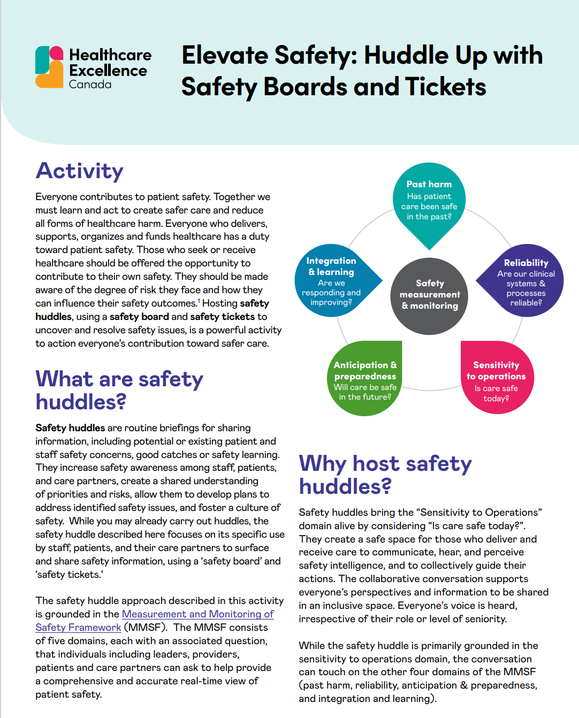
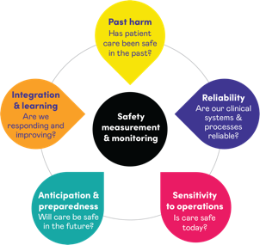
How to host a safety huddle using safety board and tickets
Notes:
Healthcare Excellence Canada has developed activity cards to help individuals, teams and organizations build Sensitivity to Operations
Safety conversations https://www.healthcareexcellence.ca/media/wwtbyst3/hec_2023_cpsw_activity_cards_en.pdf
Safety huddles, boards, tickets
Observation

Slide 49
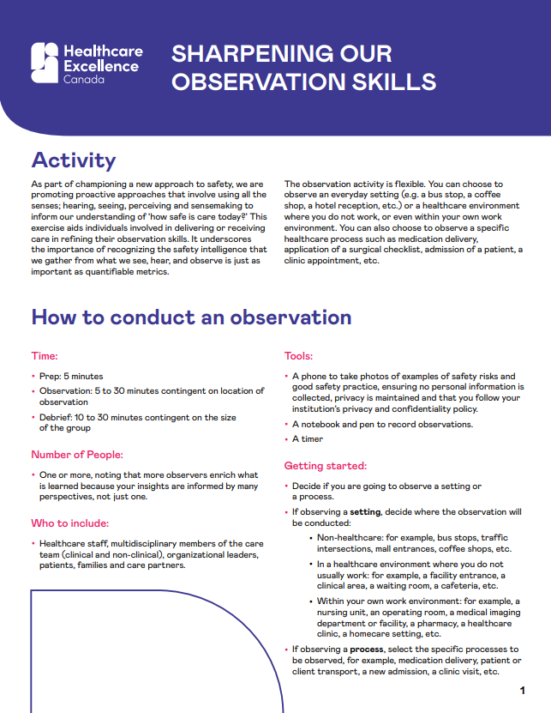
How to conduct an observation activity
Notes:
Additional resource to help tune into other sources of safety intelligence

Slide 50
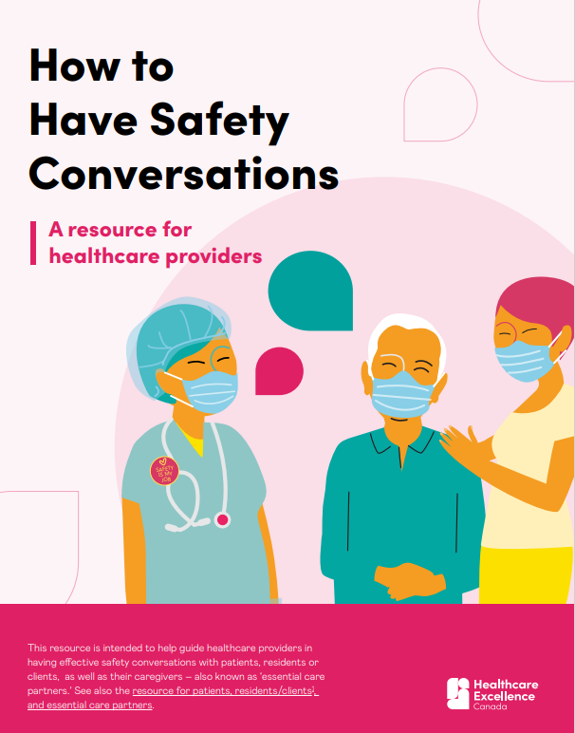
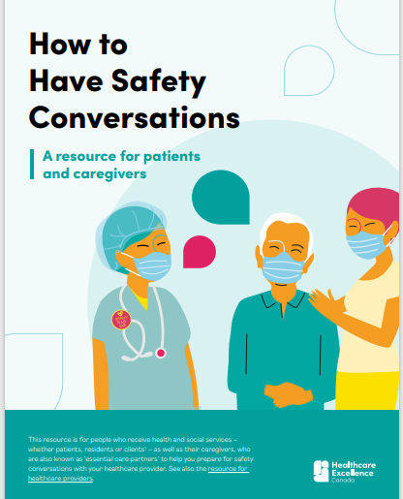
Resources to support safety conversations
How to Have Safety Conversations: For Providers (healthcareexcellence.ca)
How to Have Safety Conversations: For Patients & Caregivers (healthcareexcellence.ca)
Notes:
Resources to support safety conversations

Slide 51
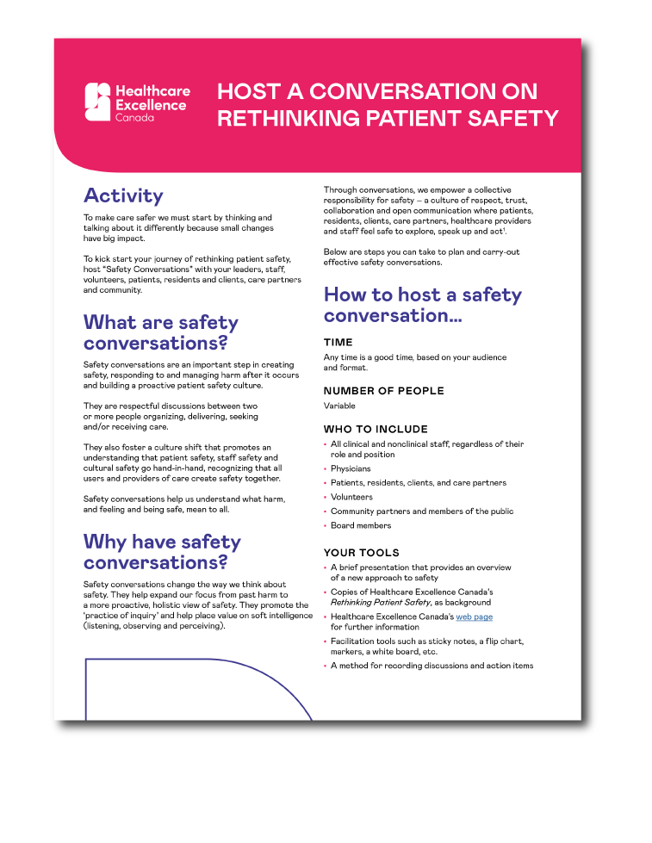
Host a conversation on rethinking patient safety
ExploreSaferCare.ca
https://www.healthcareexcellence.ca/media/
wwtbyst3/hec_2023_cpsw_activity_cards_en.pdf
Notes:
An activity card on how to host a conversation on Rethinking Patient Safety

Slide 52
Questions you can ask colleagues
What does patient safety mean to you?
How is the presence of safety different from the absence
of harm?
Tell me about anything that alarmed or worried you during your delivery of care
Who do you speak to when you have a safety concern or compliment?
Is our care safe
or are we just lucky?
How safe
is our care?
What has made you feel unsafe at work?
What do you need
to make you feel safe to raise concerns about safety?
Notes:
Conversation starters that you can use when talking to your colleagues about safety.

Slide 53
Questions you can ask patients/
residents/clients and care partners
Who would you
speak to if you
didn’t feel safe?
What makes
you feel safe?
Tell me about anything that alarmed or worried you in the past 24 hours?
What would make
you feel safer?
What makes
you feel unsafe?
What are your
care preferences?
(for example, ‘what matters to you?’)
What do you need
to make you feel safe to raise concerns about safety?
Notes:
conversation starters to help you talk to your patients/residents/clients and care partners

Slide 54
Questions you can ask patients/
residents/clients and care partners
I would feel safer if…
I’m concerned about
my or my loved one’s condition because…
I am uncomfortable
with my or my loved
one’s condition because …
I believe my safety
or the safety of
my loved one is at
risk because...
I feel
unsafe because…
What can I do to contribute to my safety?
Notes:
Conversation starters to offer your patients, residents, clients and care partners so they can talk to you about safety.

Slide 55
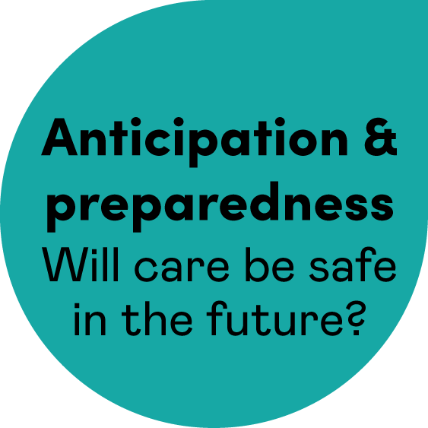
Anticipation & preparedness

Slide 56
Anticipation & preparedness -
Will care be safe in the future?
”Skate to where the puck is going, not where it has been.”
– Wayne Gretzky
Anticipation and preparedness focuses on identifying possible sources of future harm and working toward becoming more resilient to them.
Don’t wait for things to go wrong
before trying to improve safety
Notes:
Anticipation and preparedness is about “the ability to anticipate, and be prepared for, problems”
Given past harm, reliability and sensitivity to operations, what strategies can be developed to counter potential future harm?
What this is really addressing:
Don’t wait for things to go wrong before trying to improve safety
Explore new opportunities to develop systematic ways to anticipate future risks
Use a variety of tools and techniques to build an understanding of the factors that give rise to safety issues.
Developing resilience in staff so that they can detect and anticipate potential problems
Is there a risk that by focusing so much on following standards, and completing check lists, that one may lose out on developing the skill set of critical thinking .
Can you build an army of safety detectives and problem solvers by inviting curiosity and inquisitiveness?
We can develop this skill through activities and conversations.

Slide 57
Value of anticipation & preparedness
Safety monitoring is critical
  Anticipation and preparedness requires formal and informal methods to elicit safety information to understand how frontline healthcare services are delivered, followed by timely action and intervention to anticipate and mitigate risk.
Anticipation and proactive approaches and measures for safety
  Move away from using only lagging indicators to a mixed of both lagging and leading indicators. However, there are many fewer examples of ‘anticipation and preparedness’ metrics in healthcare studies than in the other four domains.
Notes:
Reference - The MMSF Full Report (2013) https://www.health.org.uk/publications/the-measurement-and-monitoring-of-safety
At the patient/client/resident level the treatment of complex, fluctuating conditions requires anticipating changes and being prepared to adjust treatment as the patient’s condition changes.
In an organisation, safety requires anticipation and preparedness on the part of clinicians and managers and the ability to assess threats to safety and take action to intervene and reduce risks at the unit/clinic/home, department, or systems level.
Patient level – Risk of falls, pressure injuries, maintaining activities of daily living deteriorating condition, etc.
Unit/clinic/community – staffing, staffing ratios, absentee rate, patient/client census, patient/client complexity, infectious outbreaks, patient safety culture, equipment, staff safety, etc.
Organizational – staffing, absentee rate, seasonal fluctuations, pandemic planning, disaster planning, infectious disease outbreak, patient safety culture, etc.

Slide 58
How do we currently answer the question “Will care be safe in the future?”
Notes:
Following a brief introduction to “Anticipation and Preparedness”,
Think and reflect on the question “How do we currently answer the question “Will care be safe in the future?”

Slide 59
Anticipation & preparedness
Looking at other data sets differently
Horizon scanning to proactively identify emerging and future safety risks

Slide 60
Safety Cloud Theme 7:
Looking at other data
sets differently
Reflective question
What other data sets might shine a light on the emerging patient and staff safety threats that our team/organization is facing?

Slide 61
Safety Cloud Theme 7:
Looking at other data
sets differently
Background
Anticipation and preparedness can be enhanced when leaders look beyond what is traditionally presented as ‘patient safety data’ in board/senior leadership reports.
All too often the patient safety data leaders are presented
with focuses on patient harm, but safety is far broader than ‘physical harm.’
Looking at data sets which are not traditionally labeled as ‘patient safety data’ enables senior leaders to proactively identify what could go wrong, before an incident occurs.
Notes:
Anticipation and preparedness can be enhanced when leaders look beyond what is traditionally presented as ‘patient safety data’ in board/senior leadership reports.
All too often the patient safety data leaders are presented with focuses on patient harm, but safety is far broader than ‘physical harm.’
Looking at data sets which are not traditionally labeled as ‘patient safety data’ enables senior leaders to proactively identify what could go wrong, before an incident occurs.
These data sets are routinely reviewed by senior leaders, so developing the habit of asking yourself the question, ‘What could be the impact on safety?’ enables you, as a senior leader, to be skilled at scanning for and anticipating future safety risks.

Slide 62
Safety Cloud Theme 7:
Looking at other data
sets differently
This safety theme cloud is asking you to:
consider how other types of data you collect in your settings might inform your understanding of future safety risks.
Examples of other types of data:
client demographics and equity stratifers,
referral rates and wait times,
leaving without being seen,
access to diagnostic testing, beds and services,
staff turnover, skill mix and sickness data,
statutory and mandatory training compliance levels
Patient experience data, including compliments and concerns
Notes:
This safety theme cloud is asking you to:
consider how operational data, for example, client demographics and equity stratifers, referral rates, wait times, leaving without being seen, access to diagnostic testing, access to beds and services, staff turnover, skill mix and sickness data, statutory and mandatory training compliance levels, or other types of data you collect in your settings might inform your understanding of future safety risks.
Additional questions from Rethinking Patient Safety to consider including in your discussion –
What does patient safety mean to you?
How is the presence of safety different from the absence of harm?
Do your safety metrics tell you have safe your care is or how lucky you have been?

Slide 63
Safety Cloud Theme 8:
Horizon scanning to proactively identify emerging and future safety
Reflective question
How do we, as leaders, ensure that we spend time horizon scanning for emerging and future safety risks to gain insight into whether care will be safe in the future?

Slide 64
Safety Cloud Theme 8:
Horizon scanning to proactively identify emerging and future safety
Background
Standards, guidelines and regulations for safety are important
and necessary.
The Measurement and Monitoring of Safety report (Health Foundation, 2013), identified that, at times, healthcare organizations become so concerned about and focused on meeting standards, guidelines and regulations that it leaves them with little bandwidth to think critically,
to create the desired safety culture, or for senior leaders to horizon scan
and proactively identify emerging or future risks to safety.

Slide 65
Safety Cloud Theme 8:
Horizon scanning to proactively identify emerging and future safety
This safety theme cloud is asking you to:
reflect on what happens in your organization – How does
your organization think critically about patient safety issues, make efforts to create the desired patient safety culture, or proactively identify emerging or future risks to safety?
share how you do or might create capacity to answer the question, 'Will care be safe in the future?'
Notes:
Additional questions from Rethinking Patient Safety to consider including in your discussion –
How have you approached safety in the past?
How might you approach it differently now?
What could you start doing? What could you stop doing?

Slide 66
How can we better answer the question “Will care be safe in the future?”
Notes:
Now that you have explored Anticipation and Preparedness, and have completed the two “Anticipation and Preparedness” safety theme clouds…
Refer to your notes from the discussion on - How do we currently answer the question “Will care be safe in the future?”
Now - think and reflect on the question - How can we better answer the question “Will care be safe in the future?”

Slide 67
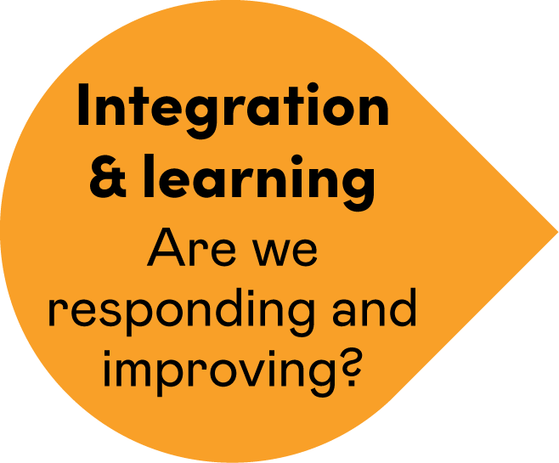
Integration & learning

Slide 68

Integration & learning:
Are we responding and improving?
Integration and Learning is the development of systems to promote a cycle of learning and sharing from safety incidents, multiple sources of safety intelligence and insights developed through the other domains.
Please don’t let this become the lost piece of the puzzle.
Plan how you are going to integrate information
and metrics, and what channels for learning and improvement you have in place
A learning system is a safe system!
Notes:
The Integration and Learning dimension has us asking the question whether we are Improving and Learning: After all, a learning system is a safer system.
This domain is about the development of systems to promote a cycle of learning and sharing from not only safety incidents, but also the multiple sources of safety intelligence and insights developed through the other domains.”
Important Points about I&L
Integration and learning is the scaffolding for the other domains
Over the past years we have made progress in reporting, responding and learning from harm, but true I & L needs to move beyond learning from harm.
Safe organisations not only report and learn from patient safety incidents, but they actively seek out information from the other domains and respond with inquiry, listening, learning and sharing .
Organizations need to determine:
how to gather and integrate patient safety information from multiple sources and then determine
How to use the information to support learning and improving
Planning how we are going to integrate safety information and metrics, and how we are going to use it to inform learning and improvement, we don’t see the safety improvements we set out to achieve.

Slide 69
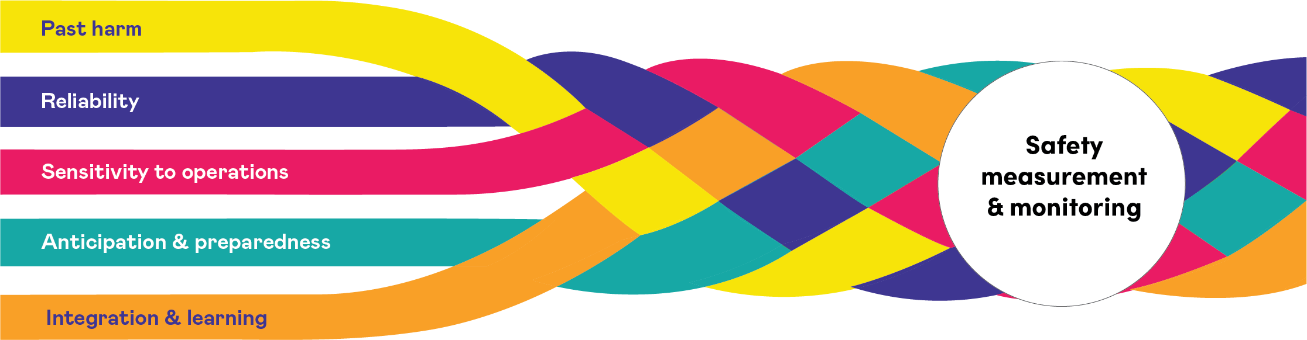
Expanded and shared understanding of “what is safety”
Notes:
Integration and learning is like weaving together 5 strands of thread to create strong rope.
When we weave together all 5 dimensions of safety, we create a much safer system.
The Measurement and Monitoring of Safety Framework provides an expanded and shared understanding of “what is safety”

Slide 70
How do we currently answer the question “Are we responding and improving?”
Notes:
Following a brief introduction to Integration and Learning
Think and reflect on the question - How do we currently answer the question “Are we responding and improving?”

Slide 71
Integration
& learning
Knowing how feedback
and learning happens
Preventing integration fog

Slide 72
Safety Cloud Theme 9:
Knowing learning happens
Reflective question
How do we, as leaders, get assurance that what is learned from safety investigations and audits
is fed back to point of care healthcare teams in
a way that supports learning and improvement?

Slide 73
Safety Cloud Theme 9:
Knowing learning happens
Background
Healthcare organizations face the challenge of how to meaningfully provide feedback on learning from incident investigations, safety audits, walk-rounds, safety culture surveys etc.
to teams for whom the learning is relevant and share more widely across the organization.
Common problems include:
  we tell staff the outcome of an audit or investigation and expect improvement to occur.
  safety learning is not shared with ‘hard to reach’ groups
  we share findings without contextualizing the learning in a way that helps staff to learn
  we feedback the learning to the team involved in the incident, without sharing more broadly across the organization
Notes:
Background: Healthcare organizations face the challenge of how to meaningfully provide feedback on learning from incident investigations, safety audits, walk-rounds, safety culture surveys etc.. to teams for whom the learning is relevant and share more widely across the organization. Common problems include:
we tell staff the outcome of an audit or investigation and expect improvement to occur.
safety learning is not shared with ‘hard to reach’ groups (for example, staff who do not access emails or the intranet, or staff who only work night shifts, staff who do not have a local office).
we share findings without contextualizing the learning in a way that helps staff to learn (i.e. through story-telling, vignettes etc..).
we feedback the learning to the team involved in the incident, without sharing more broadly across the organization, particularly other areas where this learning may be pertinent.

Slide 74
Safety Cloud Theme 9:
Knowing learning happens
This safety theme cloud is asking you to:
reflect on the approaches to feeding back learning
to teams in your organization.
reflect on how learning is fed back, and to identify any gaps in feedback loops and/or how you could check-in with teams to determine if the learning has been understood and they are supported to implement changes.

Slide 75
Safety Cloud Theme 10:
Preventing integration fog
Reflective question
How might we triangulate and integrate patient safety data in a way that does not make it difficult for senior leaders to understand what the data is telling them?

Slide 76
Safety Cloud Theme 10:
Preventing integration fog
Background
Healthcare leaders are sometimes presented with an avalanche
of patient safety metrics and information
Healthcare organizations sometimes find it difficult to stop using safety metrics and approaches even when other data exists which is more reflective of safety.
Too much information or safety metrics and data that is not clearly presented can create ‘integration fog.’
Color coding data ‘red’ ‘amber’ and ‘green’ sometimes means
leaders only look at the ‘red’ safety metrics/teams.
Integration fog makes it difficult for leaders to interpret
and decipher the data.
Notes:
Background: Healthcare leaders are sometimes presented with an avalanche of patient safety metrics and information (on dashboards/scorecards/ indicator reports and in Board/senior leadership meeting papers). Additionally, healthcare organizations sometimes find it difficult to stop using safety metrics and approaches even when other data exists which is more reflective of safety. Too much information or safety metrics and data that is not clearly presented can create ‘integration fog.’ Color coding data ‘red’ ‘amber’ and ‘green’ sometimes means leaders only look at the ‘red’ safety metrics/units/teams. Integration fog makes it difficult for leaders to interpret and decipher the data.

Slide 77
Safety Cloud Theme 10:
Preventing integration fog
This safety theme cloud is asking you to:
reflect on how your organization’s patient safety data is integrated and presented.
have a reflective conversation about how you, as leaders, navigate through your safety dashboards and safety reports.
Is there integration fog?
If yes, how could the data or reports be presented?

Slide 78
How can we better answer the question “Are we responding and improving?”
Notes:
Now that you have explored Integration and learning, and have completed the two “Integration and Learning” safety theme clouds…
Refer to your notes from the discussion on - How do we currently answer the question “Are we responding and improving?”
Now -
Think and reflect on the question - How can we better answer the question “Are we responding and improving?”

Slide 79
Additional resources
Rethinking Patient Safety
The measurement and monitoring of safety.
Measurement and monitoring of safety through the eyes of patients and their care partners
Effective Governance for Quality and Patient Safety: An eight module, self-directed learning program
EXTRA™: Executive Training Program

Slide 80
Acknowledgment
This slide deck was prepared by Healthcare Excellence Canada for use by healthcare organizations to inspire reflection and discussion around current approaches for measuring and monitoring safety in all sectors of healthcare.
Healthcare Excellence Canada (HEC) works with partners to spread innovation, build capability, and catalyze policy change so that everyone in Canada has safe and high-quality healthcare. Through collaboration with patients, caregivers and people working in healthcare, we turn proven innovations into lasting improvements in all dimensions of healthcare excellence. Launched in 2021, HEC brings together the Canadian Patient Safety Institute and Canadian Foundation for Healthcare Improvement. HEC is an independent, not-for-profit charity funded primarily by Health Canada. The views expressed herein do not necessarily represent the views of Health Canada.

